Slide 1
Batch Process Project using PySpark
Objective:
Develop and setup a Spark Pipeline that :
Extracts data from MySql Database
Write the results to a Sink (GCS Bucket)
Write a Spark Job to apply transformations
Deploy a Workflow
Setting up a MySql database (CloudSql) on GCP – Lab
Establishing Connectivity - Lab
ETL Pipeline using PySpark - Assignment
Writing the transformed data back to sink (GCS Bucket) - Assignment
Chaining together the entire process using Workflows - Lab

Slide 2
ASSIGNMENT – Part 1 | Mysql Data Extraction
STEP-1 : Develop a pyspark job to write the extracted data to a new GCS Bucket
The Output folder must be partitioned by created_at
The Output files must be in parquet format
STEP-2 : Covert the script to python file and run it using Spark Submit
The code must be split into functions

Slide 3
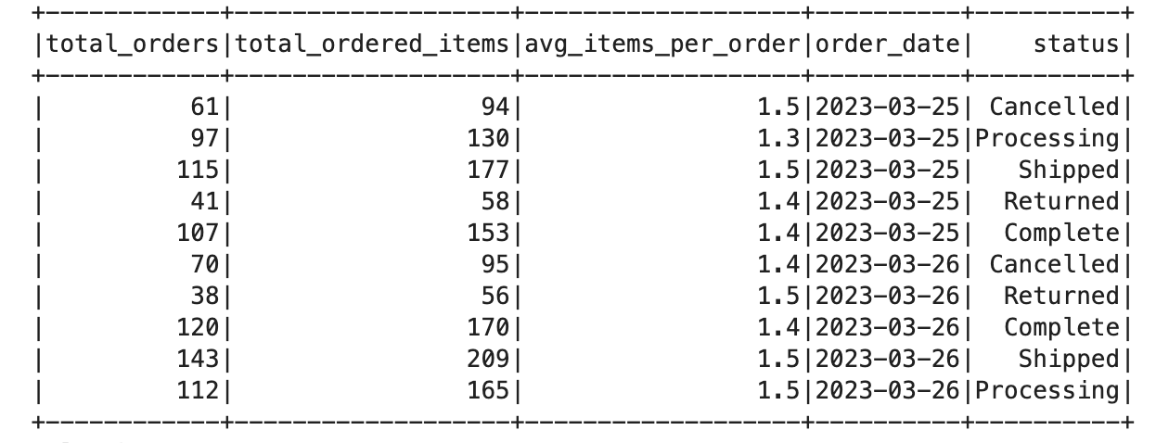
ASSIGNMENT –Spark ETL Pipeline
STEP-1 Metrics :
Total Orders
Total Items
Average Items per order
For every :
Order Date => date(created_at)
Status
Output Path : gs://bucket_name/order_status_summary/
Output File Format : Parquet

Slide 4
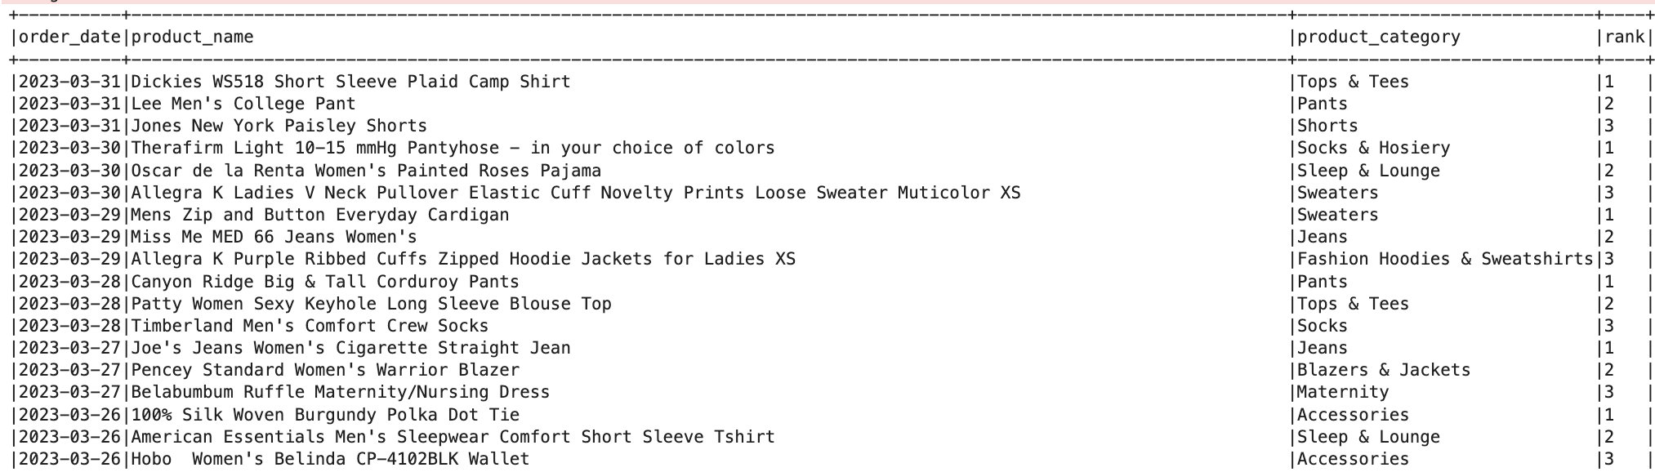
ASSIGNMENT – Part 2 | Spark Transformations
STEP-2 : Fetch the top 3 products ranked by the number of times they were sold
Attributes : product_name, product_category
For every :
Order Date => date(created_at)
Output Path : gs://bucket_name/top3_products/
2023-03-31/
2023-03-30/
…..
Output File Format : Parquet

Slide 5
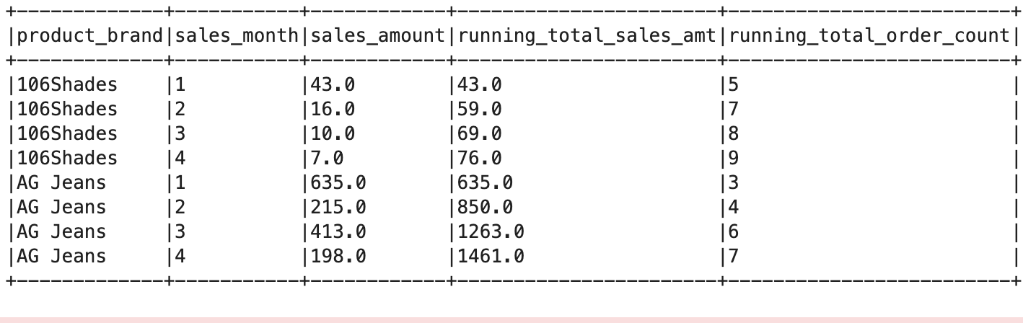
ASSIGNMENT – Part 2 | Spark Transformations
STEP-3 : Fetch the running total of the sales amount and total number of orders
For every :
Product Brand
Ordered By – sales_month
Output Path : gs://bucket_name/brand_level_running_aggregations/
Output File Format : Parquet

Slide 6
ASSIGNMENT – GCP Workflows
STEP-1 : Create a workflow template
STEP-2 : Add Mysql Extraction Job
STEP-3 : Add ETL Job (depends on previous job)
STEP-4 : Execute the workflow template

